Slide 1
American International University Bangladesh
PROJECT : Hotel-Restaurant booking & Comparison System
Course : Software Engineering
Section : L
Group No : 6
Group Members :
Name | Id
MD. SAHILUR RAHMAN | 20-43257-1
SADIR AHMED ZIDAN | 20-43263-1
ASMA SADIA ANIKA | 18-36087-1
MAHIN ZAMAN ARNOB | 18-37160-1

Slide 2
Project analysis slide 10
PROJECT IDEA
The main idea behind our project is to provide information to all the travelers who love to travel and the hotel owners who wants to expand their business through online .Our motive is to make the travel easy and comfortable . By our project user can confirm all of his/her to-do’s before going on a tour . User can book hotel according to his/her criteria and budget . Our system will provide all the detailed information about a hotel and an user can find his favorite hotel within his budget . And he/she can find resurgent according to his taste. Using this system hotel management or restaurant can also update their facilities. Anybody can use this system to know about a hotel and restaurant and can find all the helps to make a trip there .

Slide 3
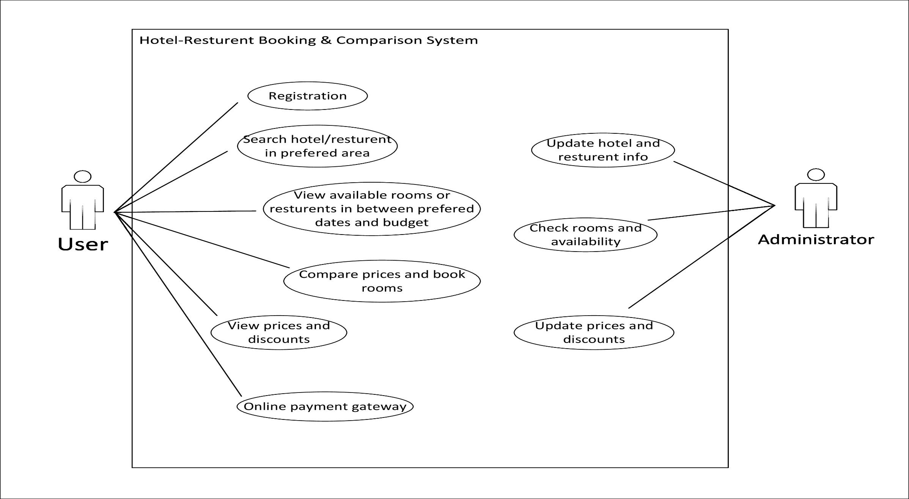
Use case diagram

Slide 4
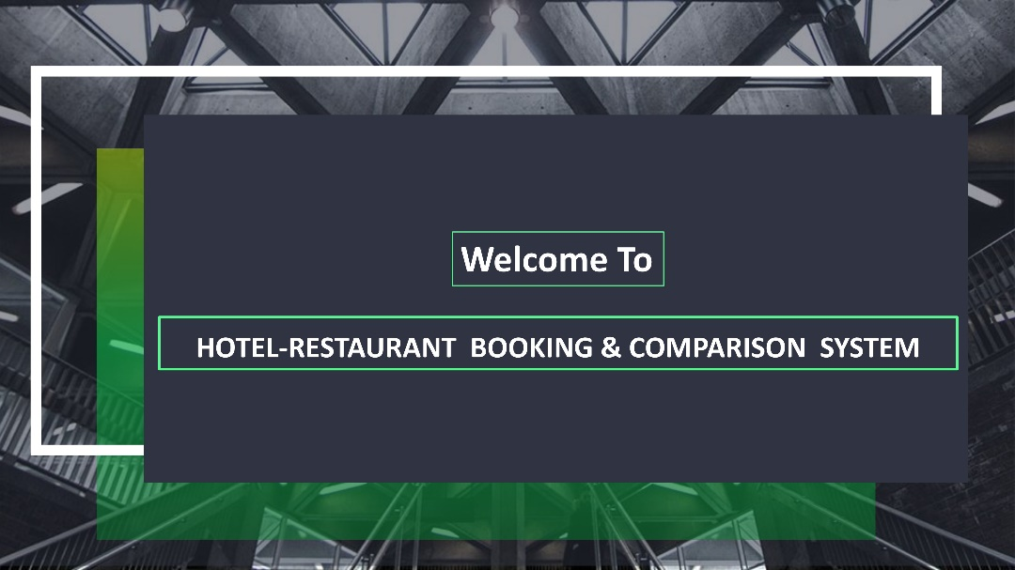
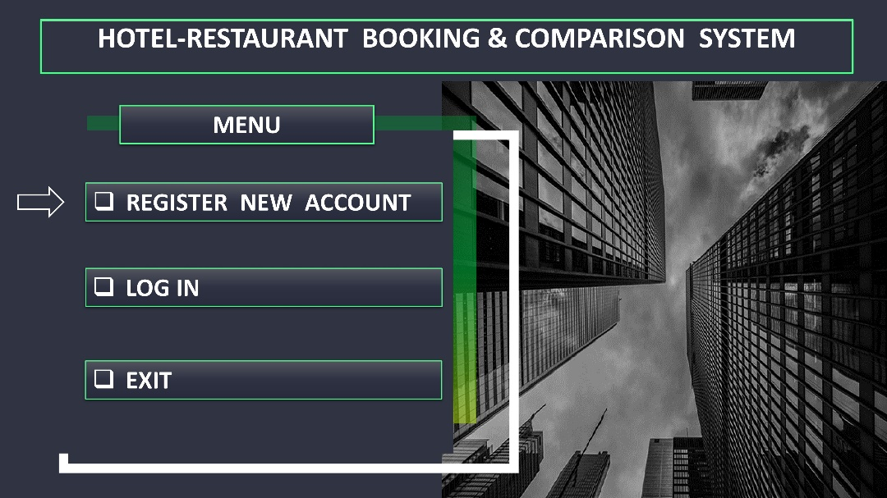
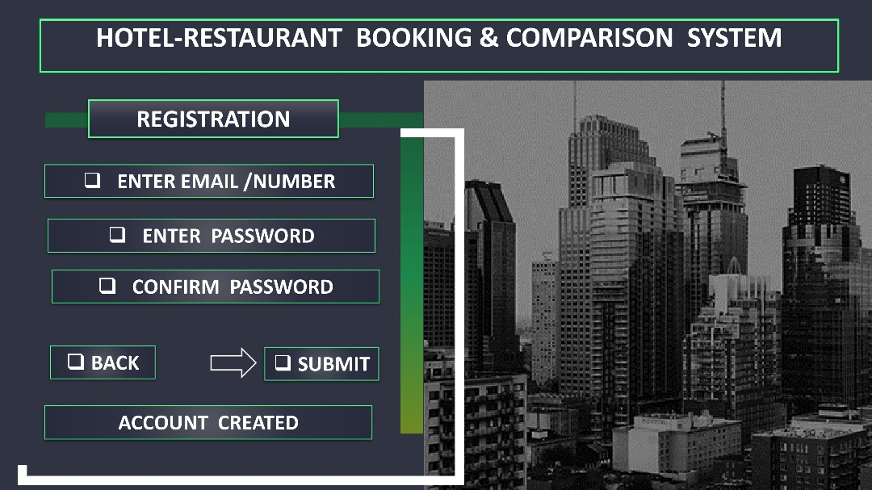
User Interface(UI)

Slide 5
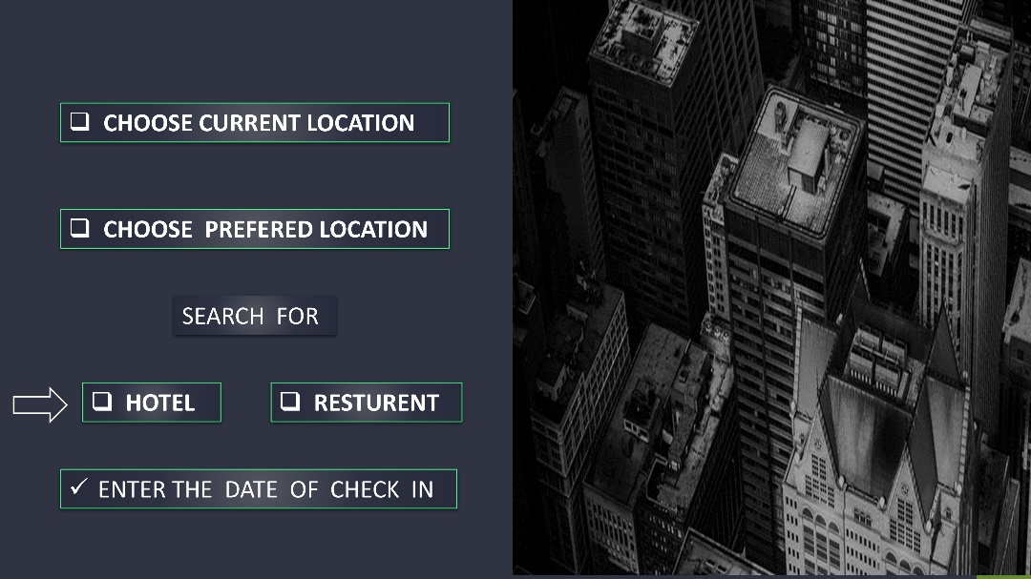
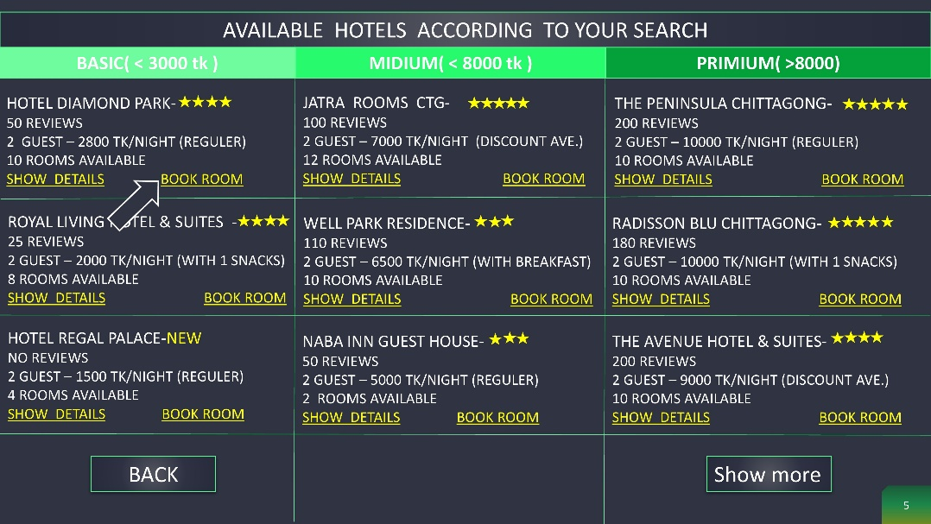
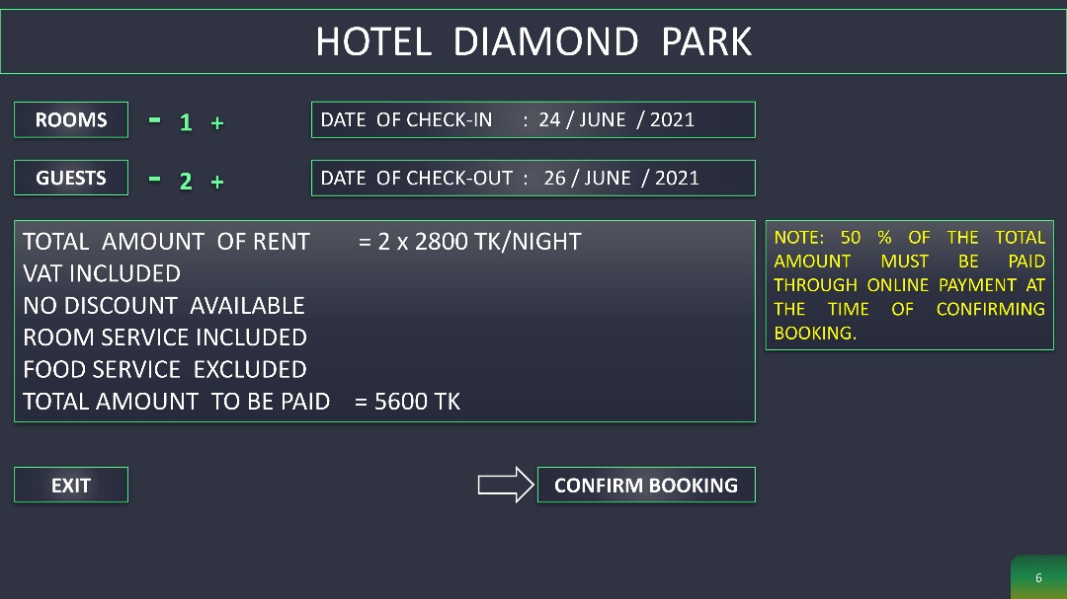
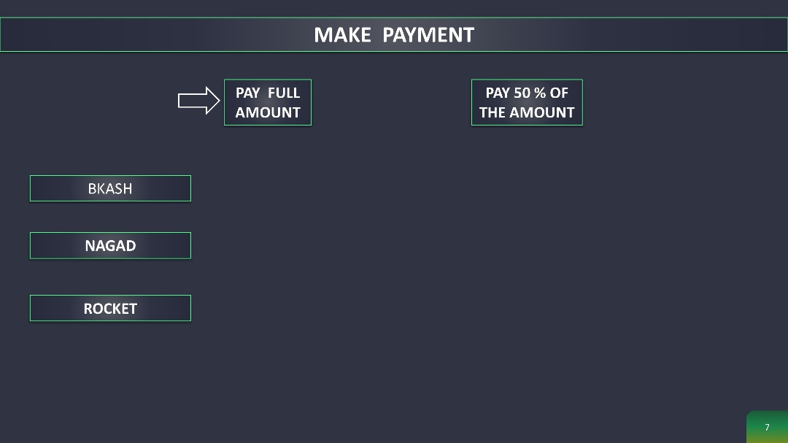
User Interface(UI)

Slide 6
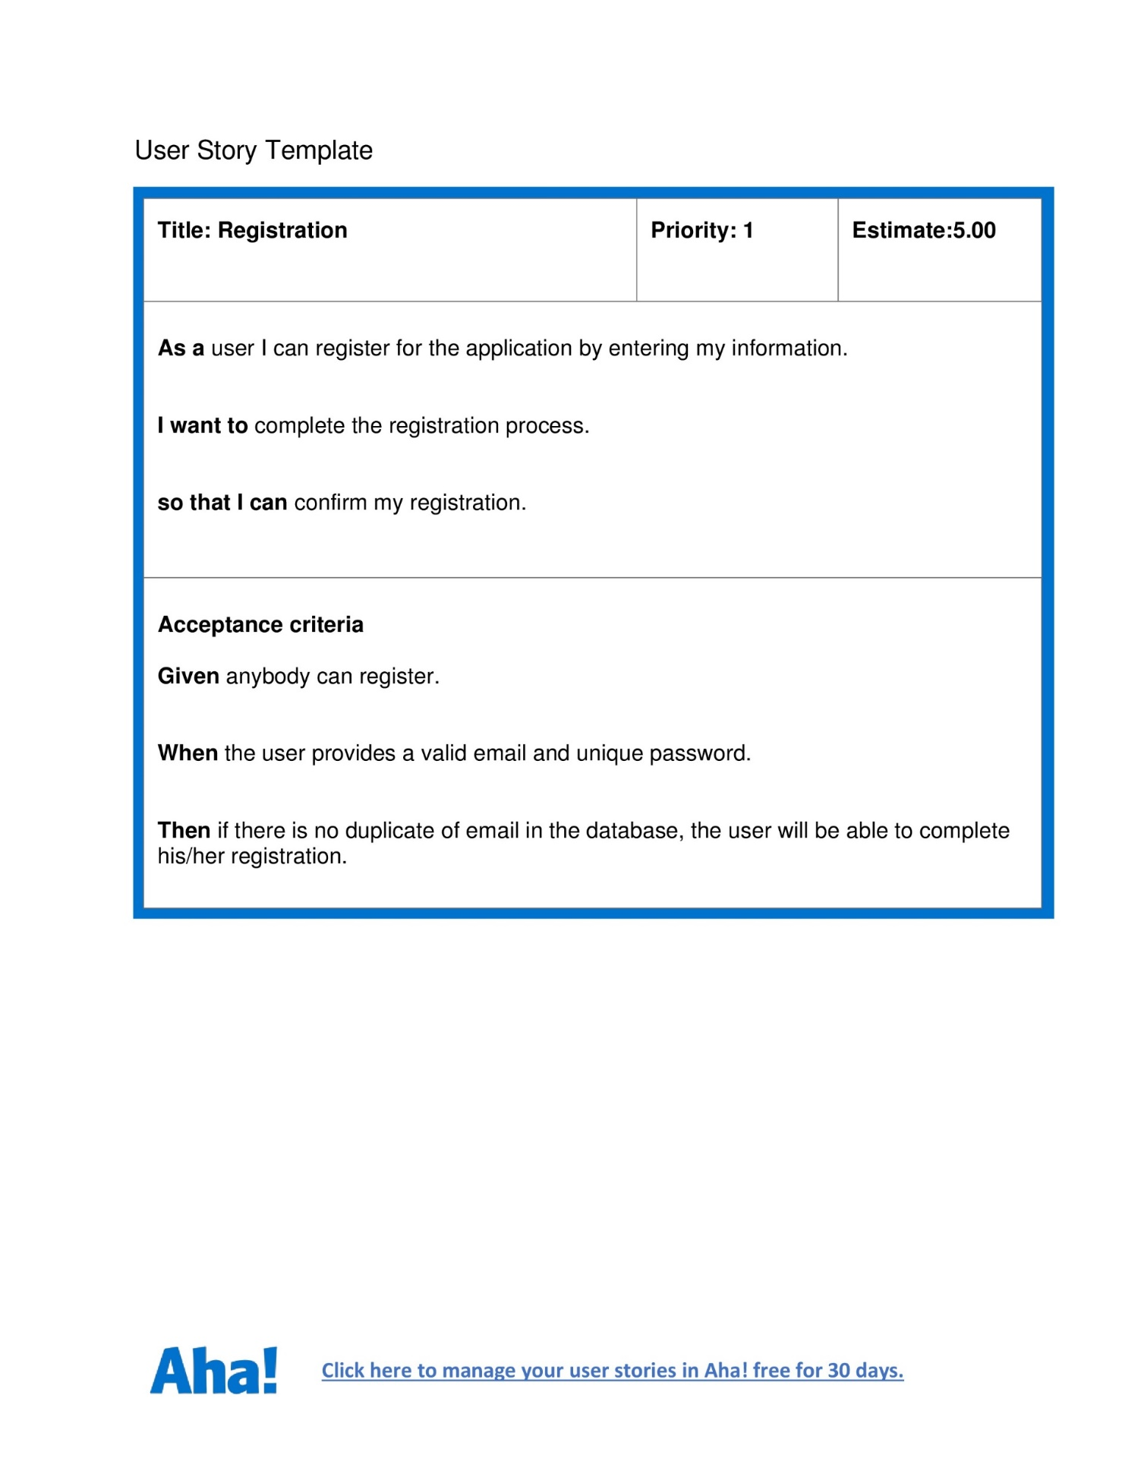
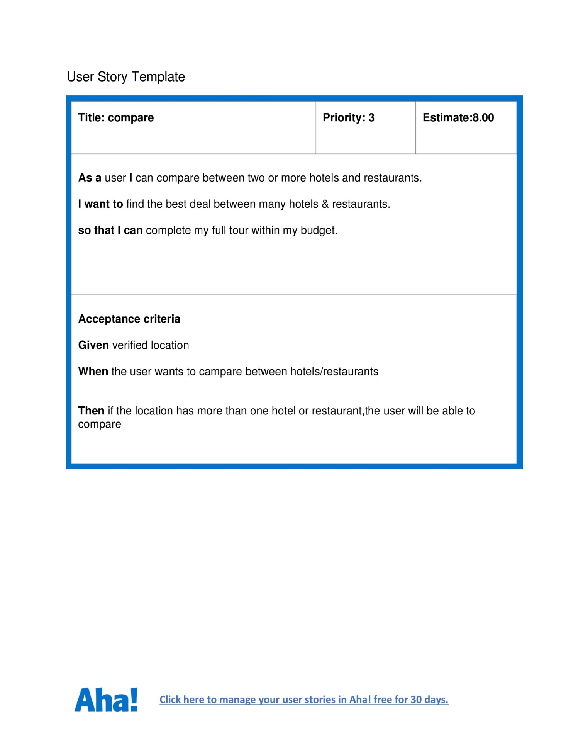
User Story Card

Slide 7

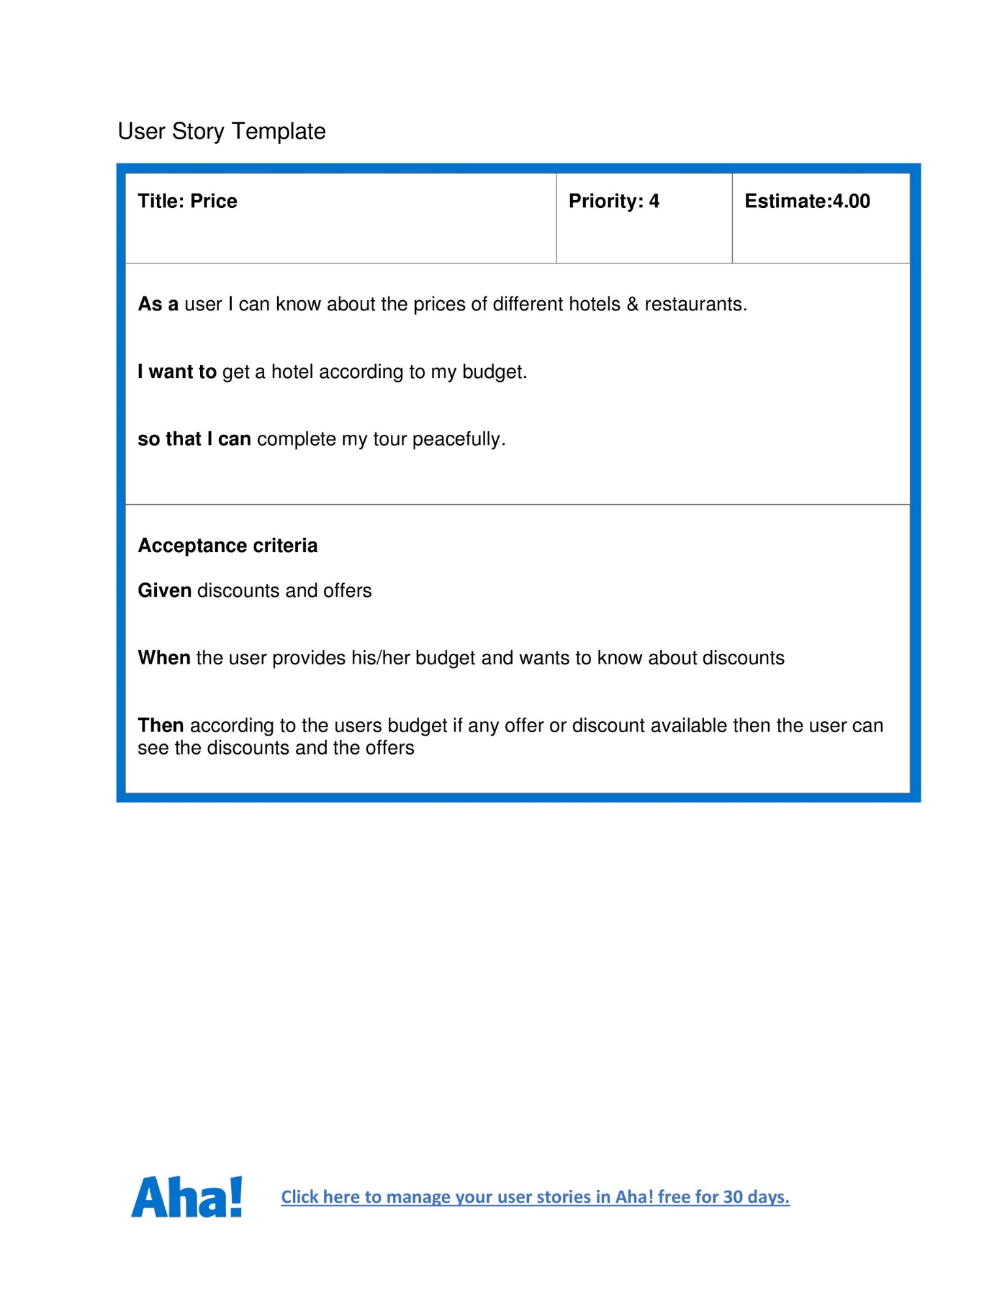
User Story Card

Slide 8
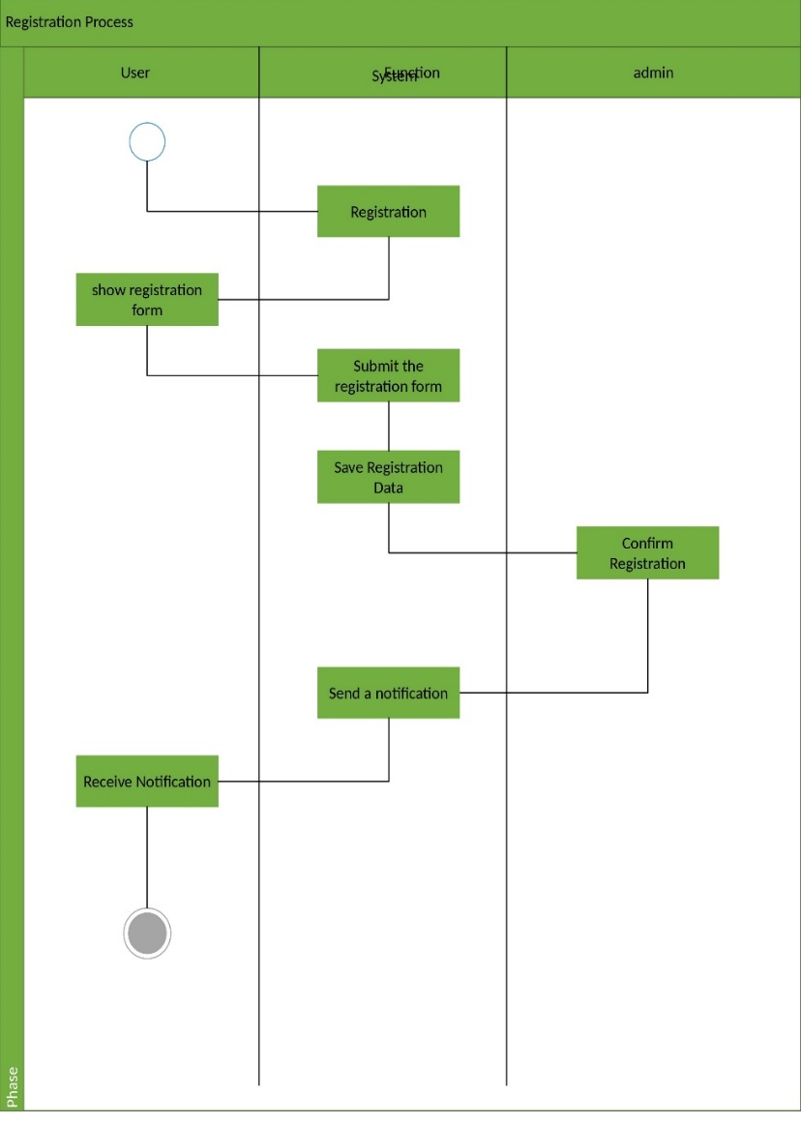
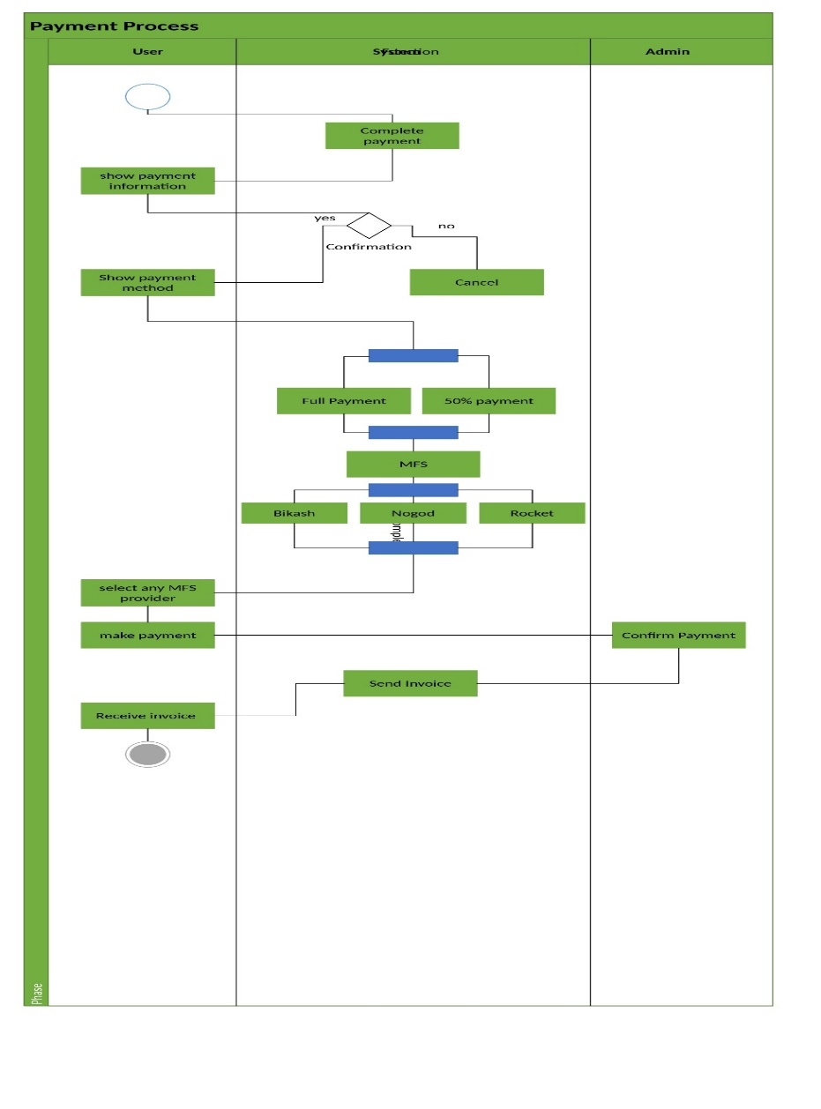
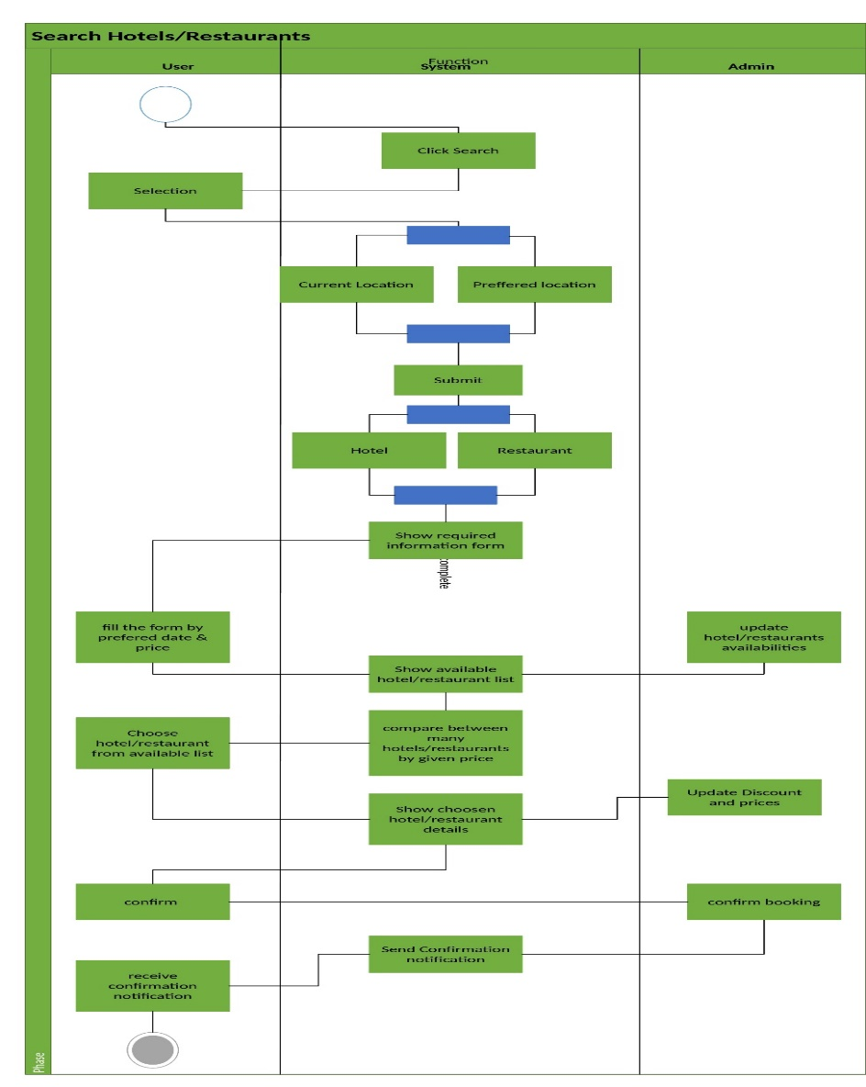
Activity diagram

Slide 9
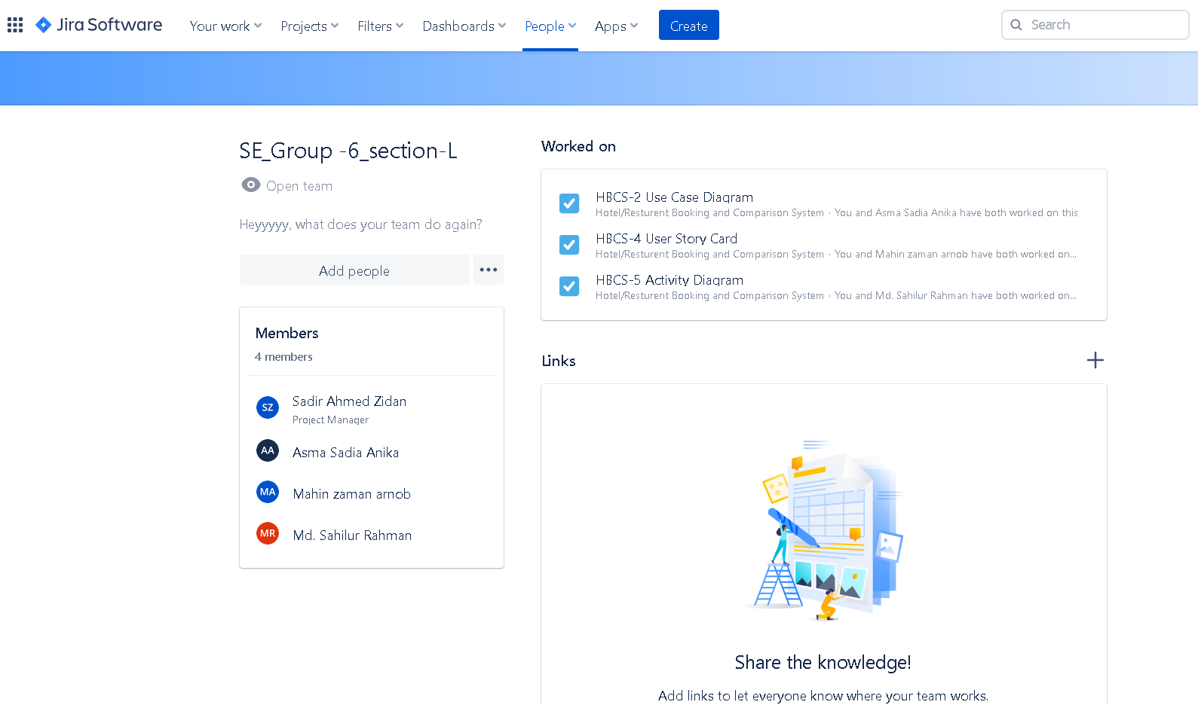
JIRA

Slide 10
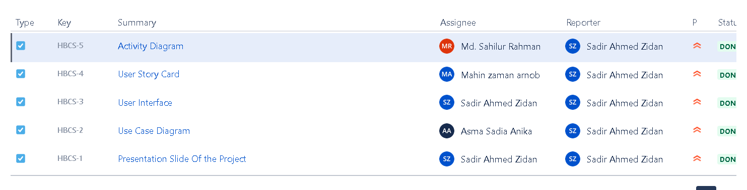
JIRA

Slide 11
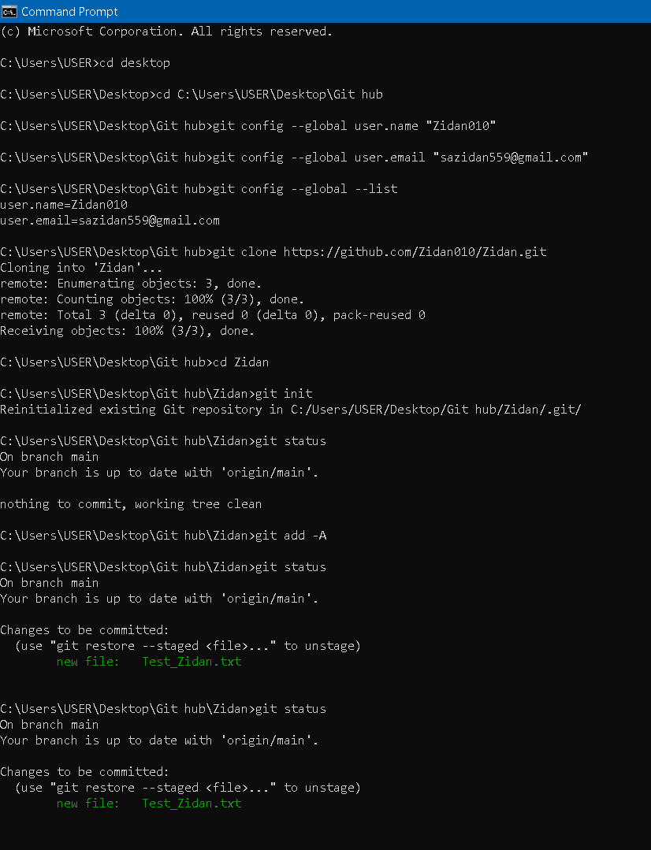
GitHub

Slide 12
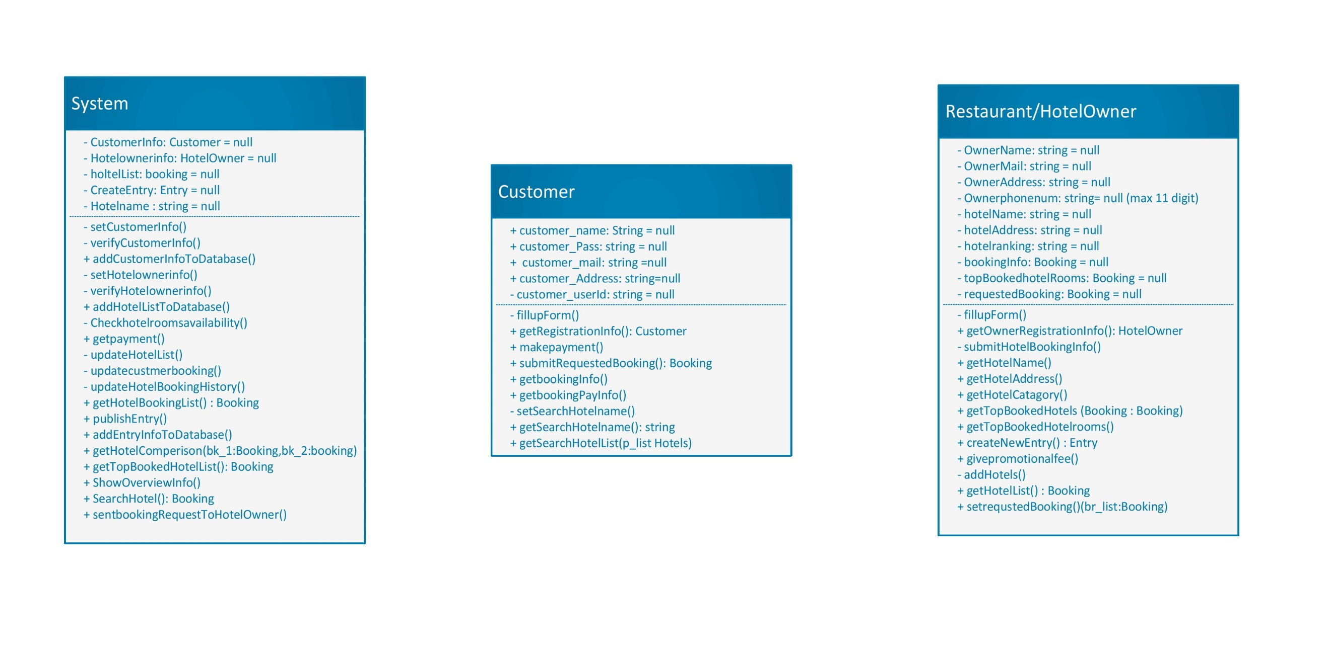
Class Diagram

Slide 13
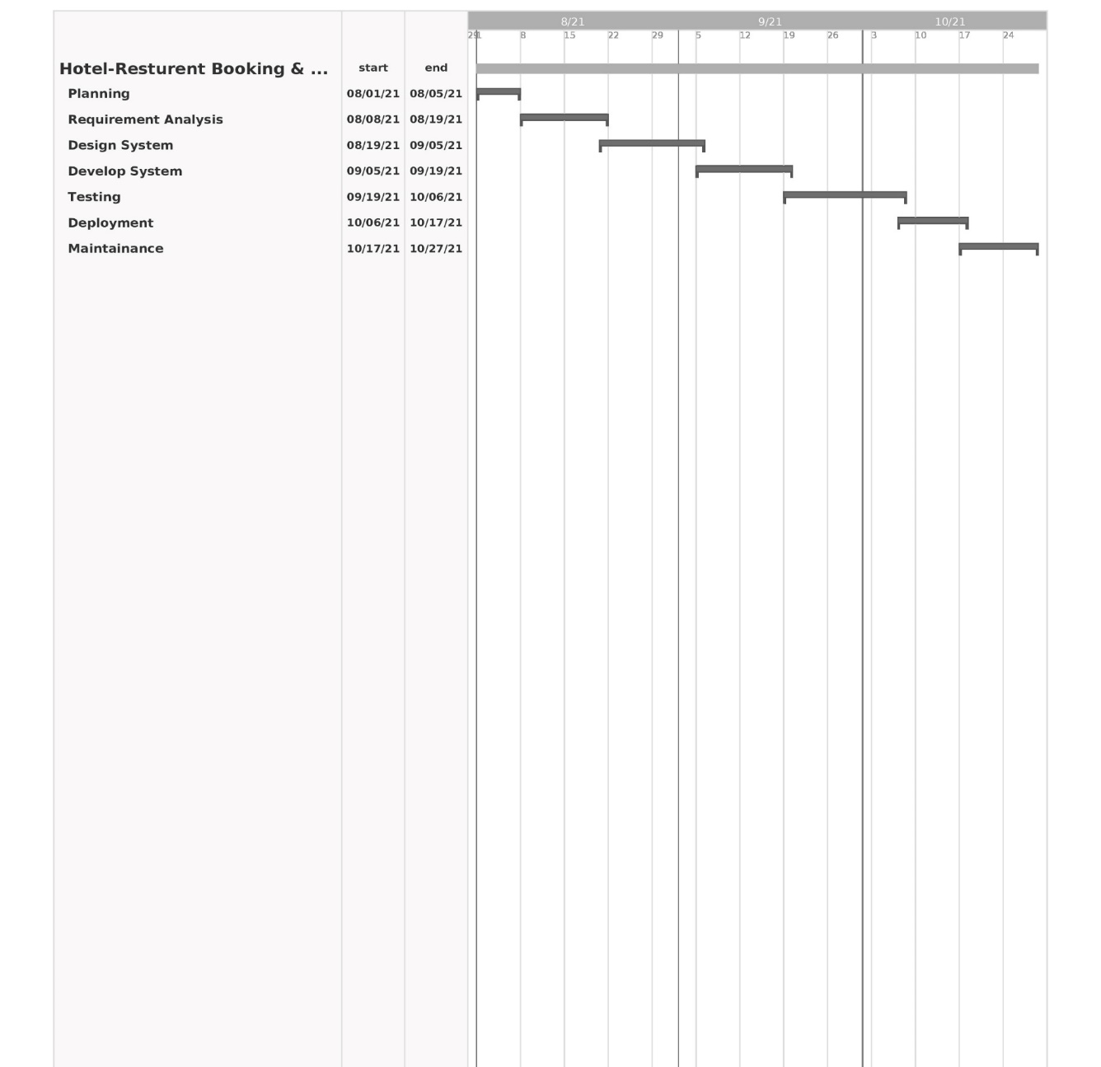
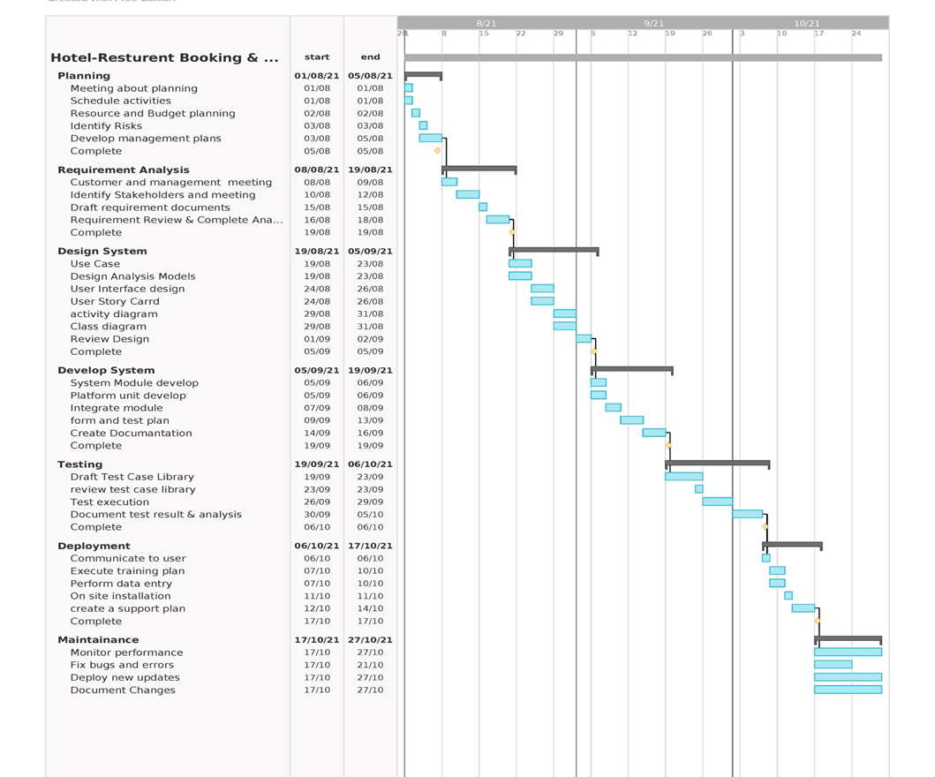
Timeline Chart

Slide 14
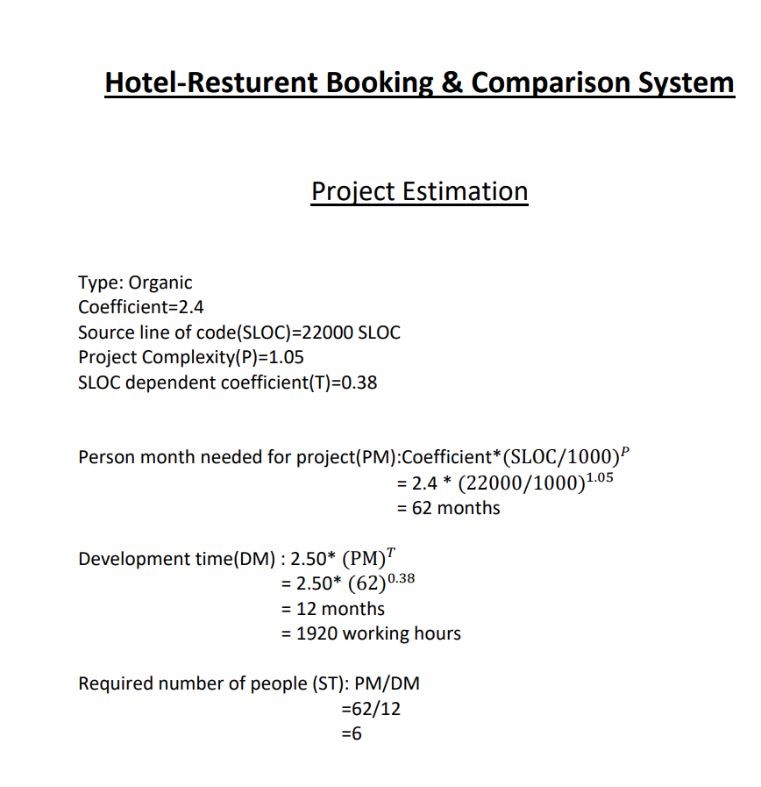
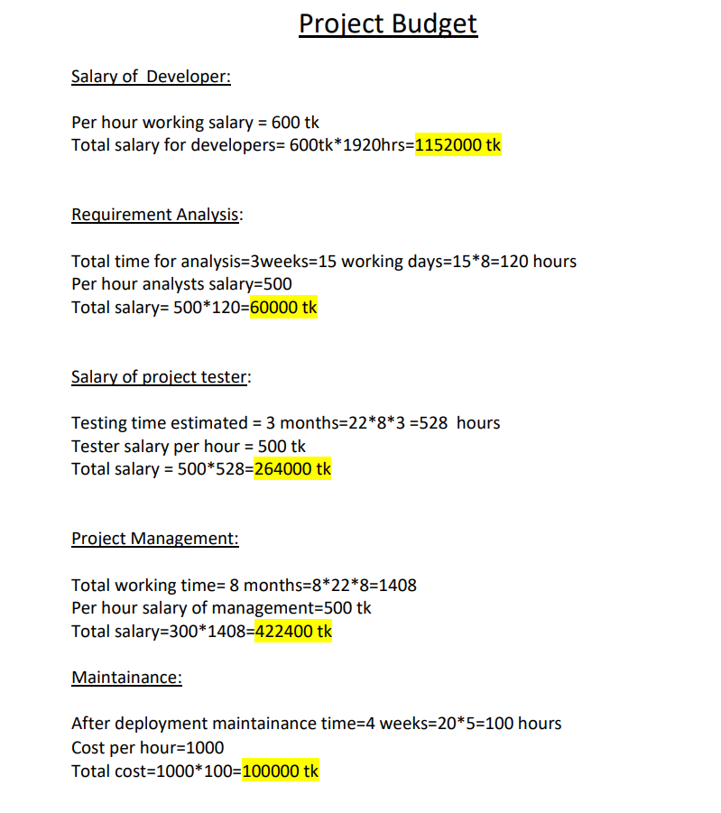
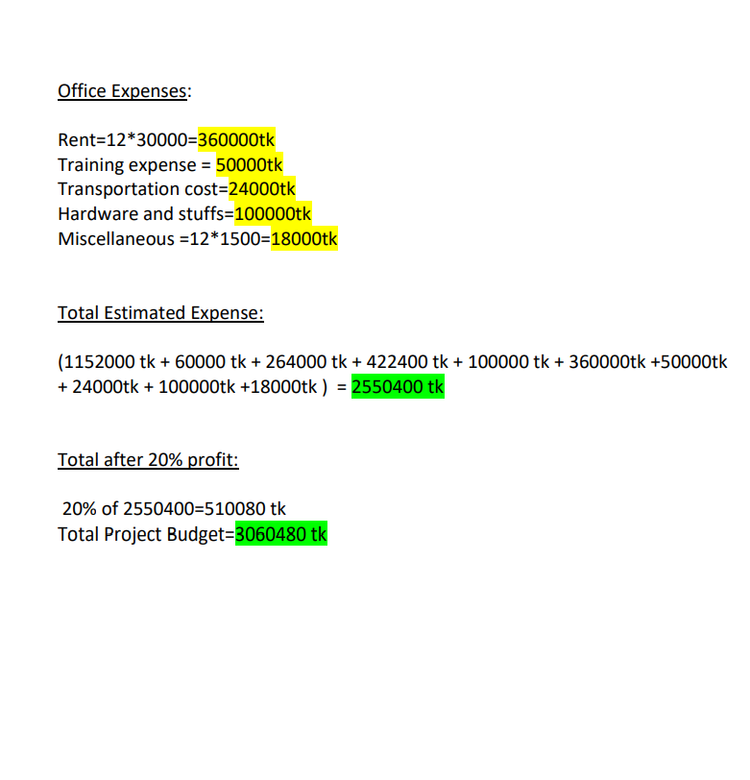
Budgeting

Slide 15
Thank You

